Slide 1
Raising the Bar in Rehabilitation of the Older Adult

Slide 2
Kathleen Walworth, PT, DPT
Board Certified Geriatric Clinical Specialist (GCS)
Advanced Credentialed Exercise Expert for Aging Adults (A-CEEAA)
kathleen.walworth@gmail.com
517-902-2032

Slide 3
Objectives
Describe physiologic changes that occur with aging and their effects on various body systems
Implement tests and measures to accurately track functional progress in the geriatric patient
Identify appropriate dosing of exercise for strengthening and balance in the geriatric patient

Slide 4
Aging Statistics
Male lifespan: 76.4 years
Female lifespan: 81.2 year
23% of men and 15% of women are still working after the age of 65
47% of the caseload of physical therapists across clinical practice settings is made up of those 66 years or older

Slide 5
Living Arrangements for those 65+
4.5% live in nursing homes
Increases to 25% over the age of 85
2.0% live in assisted living
28% live alone
72% of older men live with spouse
42% of older women live with spouse
65% of community dwellers rely on family and friends for assistance
30% supplement with hired care
10% live below the poverty line
Institute on Aging 2017

Slide 6
Most Common Comorbidities
Arthritis
Heart/circulatory disease
Vision/hearing deficits
Fracture/joint injury
Diabetes
Mental illness
Depression, dementia, other psychological disorders
Notes:
Living longer = living longer with chronic conditions
80% of patients 65+ have at least one chronic disease

Slide 7
Categories of Aging
Dependent/Frail: 25%
Independent: 50%
Fit/Elite: 5%
Notes:
Dependent – people who need assistance with ADLs and IADLs – IADL is usually first to go
Independent – fully functional now but no reserve – physical decline will be quick with illness or injury leading to frailty
Fit – highly active people who should remain mobile into late life barring significant illness or injury

Slide 8
Slippery Slope of Aging
Fun
Physical ability to do whatever one wants
Function
Those who have to make choices on their activities based on decreased physical capacity
ie: using a motorized cart at the airport to make a connecting flight due to impaired endurance/gait speed
Frail
Require assistance with IADLs and BADLs
Failure
Complete dependency and often bedbound

Slide 9
Functional Markers
 | Fun | Function | Frail | Failure
Gait Speed | >1.5 m/s | 0.8-1.5 m/s | 0.3-0.8 m/s | <0.3 m/s
6MWT | >500 m | 350-500 m | 250-350 m | <200 m
30 sec chair rise test without UE use | >15 reps | 8-15 reps | <8 reps | Unable
Stair climbing test (10 steps) | <10 sec without rails | 10-30 sec with or without rails | 30-50 sec with rails | Unable
Floor transfer | <10 sec without assist | 10-30 sec with or without assist | >30 seconds with assist | Unable
Guccione 2018
Notes:
Concept of 1RM Living: When one's max capacity is near the demands of life

Slide 10
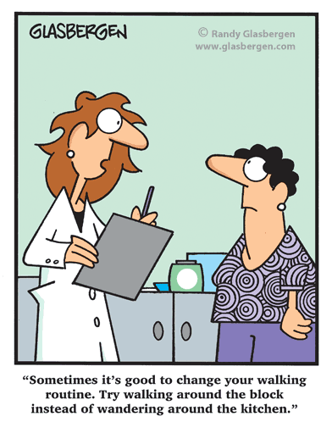
Physical Inactivity
60% of older adults are physically inactive
Difference between daily activity and intentional activity
Recommendation for 150 minutes activity/week

Slide 11
Exercise Dosing & Prescription

Slide 12
Strengthening

Slide 13
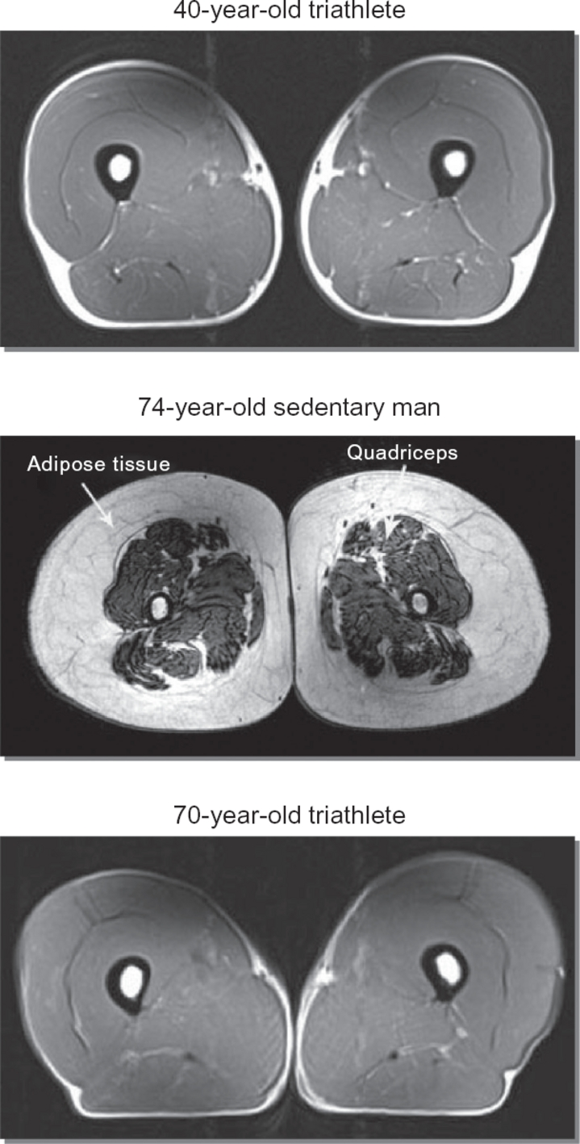
Sarcopenia
Primary treatment is to address the protein-calorie deficit and increase physical activity
Notes:
Recent clinical studies continue to show this with significant increases in muscle protein synthesis in older adults who receive physical activity and proper nutrition
Incidental activity does not count as physical activity

Slide 14
Benefits of Strengthening
Decreases sarcopenia by increasing lean muscle mass
Improves aerobic capacity
Improves function and reduces disability
**Lack of leg strength is found to be the number one most important predictor of need for eventual institution
Slows progression of chronic disease
Improves/maintains bone density
Improves gait speed and quality
Decreases fall risk
Notes:
** multiple sources

Slide 15
Strengthening
Early changes in strength are attributed to neural changes – not hypertrophy
  Not age dependent
Notes:
First 6 weeks are due to neural changes
THA example – you have not lost your strength, you just have to find it

Slide 16
Strengthening
Frequency
Intensity
3 times/week per muscle group
48 hours of rest between sessions
May reduce to 2 times/week in maintenance phases
60-80% 1 RM
Evidence suggests that if intensity of exercise is low, only minimal changes in strength will be achieved
Notes:
Even the very old and frail can exercise safely at 60-80% 1 RM
Study in 1990 with 90 year old patients in SNF with comorbidities – worked at 80% 1 RM, 3x/wk x 8 weeks
No injuries or events, excellent attendance
All made significant gains in gait speed and stair climbing
Average strength gain was 174% 1RM

Slide 17
Determining Intensity
Fairly Light
Somewhat Hard
Hard
Do a few reps then stop and ask the patient to rate their performance
If fairly light – increase the resistance
If hard – reduce the resistance
60-80%: high intensity
  8-12 reps
  Somewhat hard to hard
30-60%: moderate intensity
  12-25 reps
  Fairly light to somewhat hard
Low intensity + high reps = power
High intensity + low reps = strength
Notes:
Strength to stand from a chair
Power to do it in a reasonable amount of time

Slide 18
Determining Intensity
Patient should be able to move through their full available, pain-free ROM
Patient should demonstrate good technique without substitutions
Ensures target muscles are being addressed
Lower risk of injury
Strengthening should NOT be painful during the activity
Discomfort is ok
Notes:
Temporary pain may be ok – ie knee pain during squats but goes away after pt stops

Slide 19
Intensity - Speed
Slower movements trend toward better gains in strength
Patient should be able to “stop on a dime” when instructed to do so
Patient should be able to effectively control the movement
Indicates resistance is appropriate
Lower resistance allows for greater control and less risk of injury
Notes:
Demonstration with theraband

Slide 20
Signs of Muscle Fatigue
Increased speed
Deterioration in form
  Shaking
  Decreased ROM
  Use of compensatory musculature
If patient can return to proper form when prompted – you have not yet reached momentary fatigue
Notes:
Don’t have to ask a patient if they need a break or if it’s too hard
Can overcome greater resistance with increased speed
Once momentary muscle fatigue is achieved, that set of exercises is complete
Theraband demonstration

Slide 21
Progression
Intensity 30-60%
Intensity 60-80%
Remain at current level if able to perform 12-25 reps with good form
Increase by 10% if able to perform greater than 25 reps
Remain at current level if able to perform 8-12 reps with good form
Increase by 5% if able to perform greater than 12 reps
Notes:
Single set of reps per exercise increases pt compliance with program

Slide 22
Duration
Length of session dependent on:
  Patient tolerance
  Number of muscle groups being addressed
  Patient diagnosis
Notes:
Talk about specific diagnoses later

Slide 23
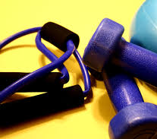
Mode
Exercise bands/cords
Free weights
Machines
Body weight
Medicine balls
Weighted bars
Functional activity
Notes:
Functional activity – stair climbing or step-ups, weight carries, lifting

Slide 24
Muscle Soreness
Optimal strengthening will create delayed onset muscle soreness
Microscopic trauma to the muscles
Stretching of joint capsules
Build up of lactic acid
Mainly occurs with eccentric muscle activity
Importance of controlling the movement both ways during exercise
Always ask about performance of HEP
Notes:
Always warn your patients that this will likely happen so they can be prepared
Should resolve in a day or two – if not consider altering program to improve compliance
Example – Gary, 73 years old, national level volleyball
Chris – 50 reps with new TKA

Slide 25
Contraindications
Recent/unstable fractures
Advanced CHF
Active cancer at the target site
Unstable or recent angina
Acute illness

Slide 26
Case Study
Dennis

Slide 27
Dennis
82 year old male
Arthritis
Asthma
LBP
DMII
GERD
RCT (R x 2, L x 1)
Connected through Aging Mastery: Exercise and You
Frequent Direct Access patient

Slide 28
Right Reverse Total Shoulder
2 weeks in sling
6 weeks of HEP assigned by surgeon
  PROM/AAROM
  No strengthening
Start OP PT at 8 weeks post-op
Goals
  Return to daily exercise routine
    Biking
    Kayaking
  Carry laundry up/down stairs
  Pick up the dog
  Snorkel in Florida

Slide 29
Objective Findings
Shoulder A/PROM | Eval: 6-29-21
 | Left | Right
Flexion | 149 | 80/112
Abduction | 147 | 75/97
ER |  | 26/29
IR |  | NT
Hand Behind Back | T8 | NT
Hand Behind Neck | T2 | NT
Shoulder MMT | Eval: 6-29-21
 | Left | Right
Flexion | 4+ | NT
Abduction | 5 | NT
ER | 3 | NT
IR | 5 | NT

Slide 30
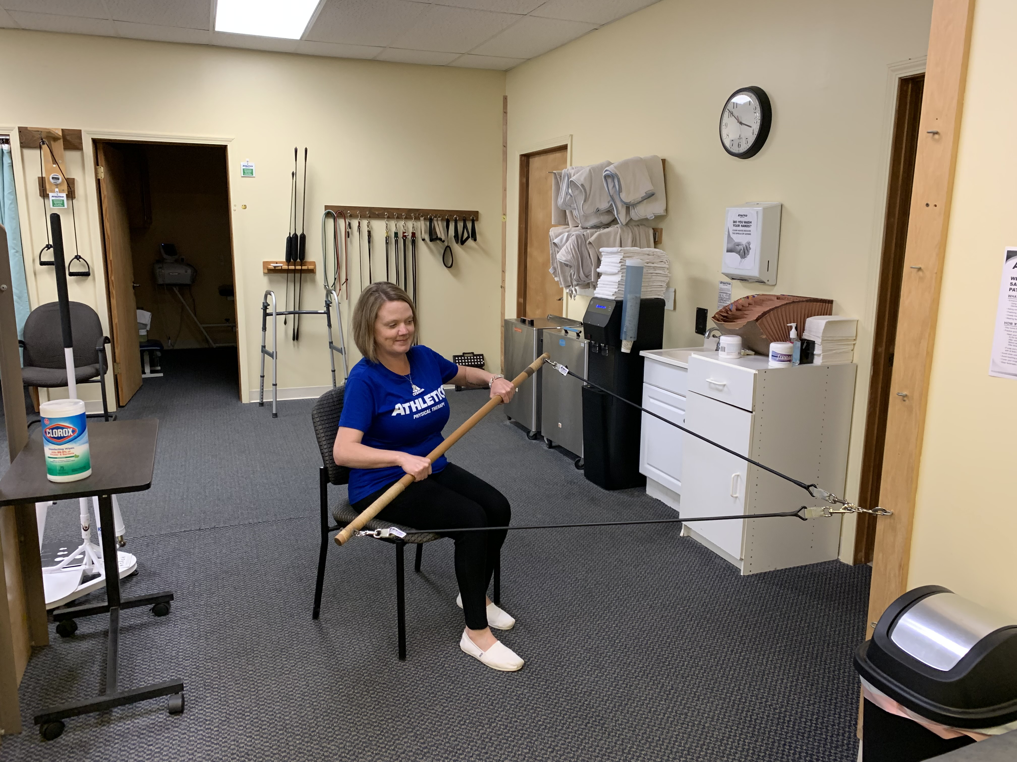
Treatment
Follow Post-Op Guidelines/Protocol
  8-12 weeks: submaximal strengthening
    30-60%: 12-20 reps
  12 weeks: isotonic strengthening with good form, follow weight lifting restrictions
    60-80%: 8-12 reps
Keep function in mind
  Cupboard reaches, crate lifts/transfers, weight carries, floor transfers, etc.
Notes:
Surgeon granted return to kayaking at 12 weeks

Slide 31
Objective Findings
Shoulder A/PROM | Eval: 6-29-21 |  | Discharge: 9-14-21
 | Left | Right | Right
Flexion | 149 | 80/112 | 152
Abduction | 147 | 75/97 | 162
ER |  | 26/29
IR |  | NT
Hand Behind Back | T8 | NT | L2
Hand Behind Neck | T2 | NT | T2
Shoulder MMT | Eval: 6-29-21 |  | Discharge: 9-14-21
 | Left | Right | Right
Flexion | 4+ | NT | 4
Abduction | 5 | NT | 4+
ER | 3 | NT | 4
IR | 5 | NT | 3

Slide 32
Aerobic Capacity/Endurance

Slide 33
Recommendations
Consider your patient and meet them where they are
Start with strength training and then move into endurance training

Slide 34
Aerobic Capacity/Endurance
Frequency
Intensity
3-7 days per week
5-7 days per week if intensity is low or of short duration
Duration 30-40 minutes
  Begin with what is tolerated
ACSM recommends healthy adults exercise within 60-80% heart rate reserve (HRR)
Frail elderly recommendation is 40%
Notes:
Remember: 5 min of ex is better than 0 min of ex – meet your patient where they are at
Can do several 5 minute bouts of exercise over the course of your treatment
Can spread it out throughout the day

Slide 35

Target Heart Rate
HRmax = 220 – age
  Low estimate
HRmax = 208 – (0.7 x age)
HRR = HRmax – Resting HR
Target HR
  THR = HRmax x (desired % intensity)
  THR = (% intensity x HRR) + HRrest
    Karvonen Formula
Notes:
Practice

Slide 36
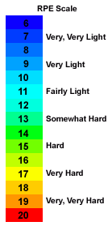
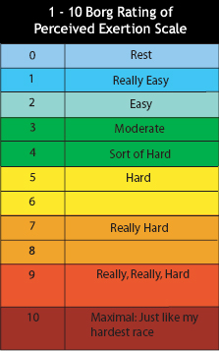
BORG RPE Scale
Notes:
Should be measured pre- during- and post- exercise for accuracy
I prefer the 0-10 point scale for ease of use
6-20 scale frequently used in research

Slide 37
Modified Scale | Ordinal Scale | Effort | Perceived Workload | Talk Test
 | 6 | 20% | Very, very light | Rest
 | 7 | 30%
 | 8 | 40%
1 | 9 | 50% | Very light | Gentle walking
2 | 10 | 55%
3 | 11 | 60% | Fairly light | Steady pace, not breathless
 | 12 | 65%
4 | 13 | 70% | Somewhat hard | Brisk walk, can converse easily
 | 14 | 75%
5 | 15 | 80% | Hard | Very brisk walk Breath every 4-5 words
6 | 16 | 85%
7 | 17 | 90% | Very hard | Unable to talk and keep pace
8 | 18 | 95%
9 | 19 | 100% | Very, very hard
10 | 20 | Exhaustion
Guccione, 2018

Slide 38
Response Parameters
Normal
Abnormal
RPE within 3-7
SBP increase by 20-30 mm Hg
BP returns to within 10 mm Hg and HR returns to within 10 bpm of baseline values within 5 minutes of stopping ex
Failure to return to baseline
DBP drops 10-20 mm Hg
SBP rises above 210-240
DBP rises above 110
HR drops greater than 10 bpm
HR rises abnormally quickly with low level activity

Slide 39
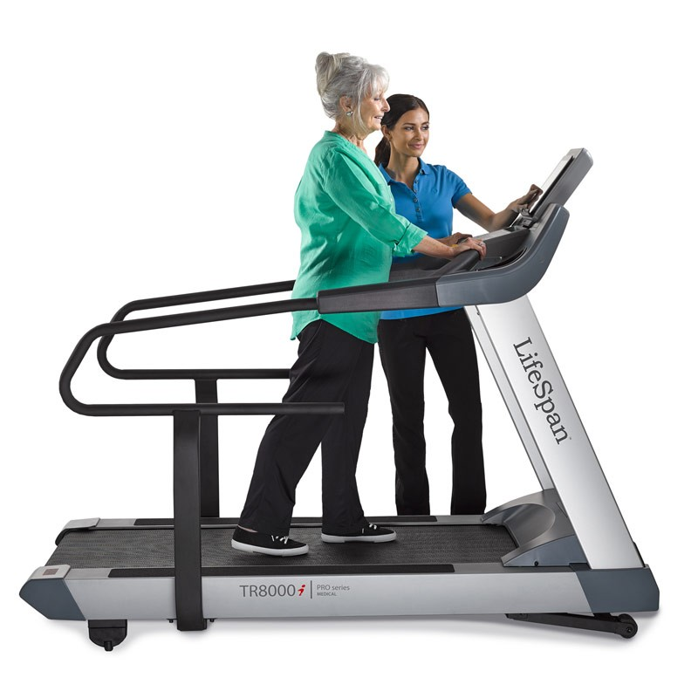
Mode of Exercise
Walking
Jogging/Running
Swimming
Zumba
Cardio drumming
Treadmill
Elliptical
Bicycle
  Stationary, recumbent, NuStep, UBE
Stair stepper
Notes:
Jump rope
Mini tramp
Find something that your patient enjoys – will allow for greater long term follow through with HEP
Treadmill burns the most calories of any standard aerobic machine!
NEVER walk away from your patient on a machine the first few times – my patient stopped walking on the TM when he got to 5 min (3.5 mph!).

Slide 40
Mode of Exercise
Alternate periods of rest and activity – interval training
Vary the activity within the session – circuit training
Vary the activity within the week – cross training
Keep it interesting
Prevent overtraining
  Injury and fatigue
Notes:
Monday – walking
Tuesday – yoga
Wednesday – spin class
Thursday – swimming
Friday – walking

Slide 41
Early Stages
Longer warm ups/cool downs (10-15 min)
15-30 minutes of activity per session
Moderate intensity (40-60%)
3-4 days per week
Lasts 1-6 weeks
Notes:
CEEAA Progression
Keep in mind these are guidelines for healthy adults – will need to take special considerations with certain populations – tomorrow’s lecture

Slide 42
Training Stage
Warm up/cool down (5-10 minutes)
25-40 minutes of activity
Intensity 60-85%
3-5 days/week
Lasts 4-8 months

Slide 43
Maintenance Stage
Warm up/cool down (5-10 minutes)
Activity 20-60 minutes
Intensity 70-85%
3-5 days/week
Lasts indefinitely if patients find it important and enjoyable

Slide 44
Gait Training

Slide 45
Community Ambulation
1203 feet (367 meters) to complete a community errand
  Club warehouse: ½ mile (676.8 meters)
Gait speed of 1.2 m/s
Average need to carry 6.7 lbs (3 kg)
Community challenges: uneven surfaces, stairs, curbs, gravel, grass…
Postural transitions: head turns, reaching, looking up, moving backward, twisting…
Knee extension and grip strength can predict declines in gait speed and self reported mobility disability
Notes:
Starting point goal should be 200 meters (656 ft) for return to community independence
Shortest distance required averages 52 meters – post office
Essential destinations: bank, doctor’s office, grocery store, pharmacy
Essential to some: gas station, church, post office, large hospital based doctor office
Non-essential destinations (QOL places): restaurants, senior centers, malls, cemeteries, library, beauty parlour

Slide 46
Gait
Frequency
Intensity
5-7 days/week
Work on the edge of limitation
  Changes in speed
  Changes in surfacing
  Changes to environment/stimuli
  Dual task demands
  Use of assistive devices?

Slide 47
Mode
Step length
Head movements
Heel walking
Toe walking
Karaoke
Braiding
Tandem walking
Use of resistance bands/weights
March
Jump
Skip
Run
Obstacles
Planes
Notes:
Don’t just walk your patient down the hall or around the clinic!
Planes: Sagittal, frontal, transverse

Slide 48
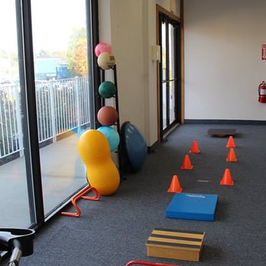
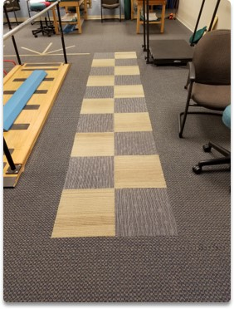
Notes:
Practice

Slide 49
Balance Training

Slide 50
Balance
Frequency
Intensity
3-5 days/week
Work on the edge of limitation
  Change surfacing
  Eyes open/closed
  Sitting vs standing
  Addition of dynamic UE or LE movements
  Change speed
  Alter degree of movement

Slide 51
Mode
BoSU
Airex
Dynadisc
Foam rollers
Foot placement
Stepping strategies
Furniture movers/paper plates
Free weights
Theraband

Slide 52
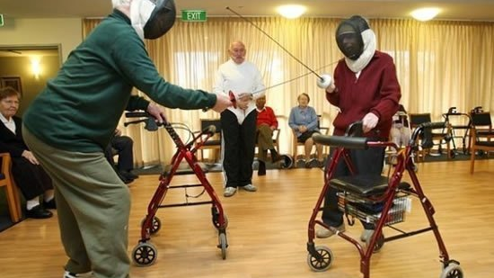
Notes:
2016 Senior Olympics
What is it your patient wants to get back to?
Karen – Skydiving
Kathleen – Downhill skiing

Slide 53
Case Study
Debbie

Slide 54
Debbie
76 year old female
  Arthritis
  Low back pain
  GERD
  Hypertension
  Urinary incontinence
  Osteoporosis
  Peripheral vascular disease
Fell down a flight of stairs while moving boxes
  Deep bone bruise to the L femur
  Concussion with LOC
  Multiple contusions
Hospital x 4 days
SNF for rehab x 4 weeks
  Fell getting into the car to go home – no injury
“Fired” the home therapist

Slide 55
Debbie
Goals
  Get rid of the “babysitters”
  Ditch the walker and then the cane
  Go shopping with her granddaughter
  Become a volunteer in the community

Slide 56
Objective Findings
 | Eval: 7-19-2021 | Norms
LEFS | 6/80
5x Sit to Stand | 33 seconds with UEs | 13 seconds no UEs
Gait Speed | 0.5 m/s | 1.13 m/s
TUG | 22 seconds with 4ww
Notes:
Frail

Slide 57
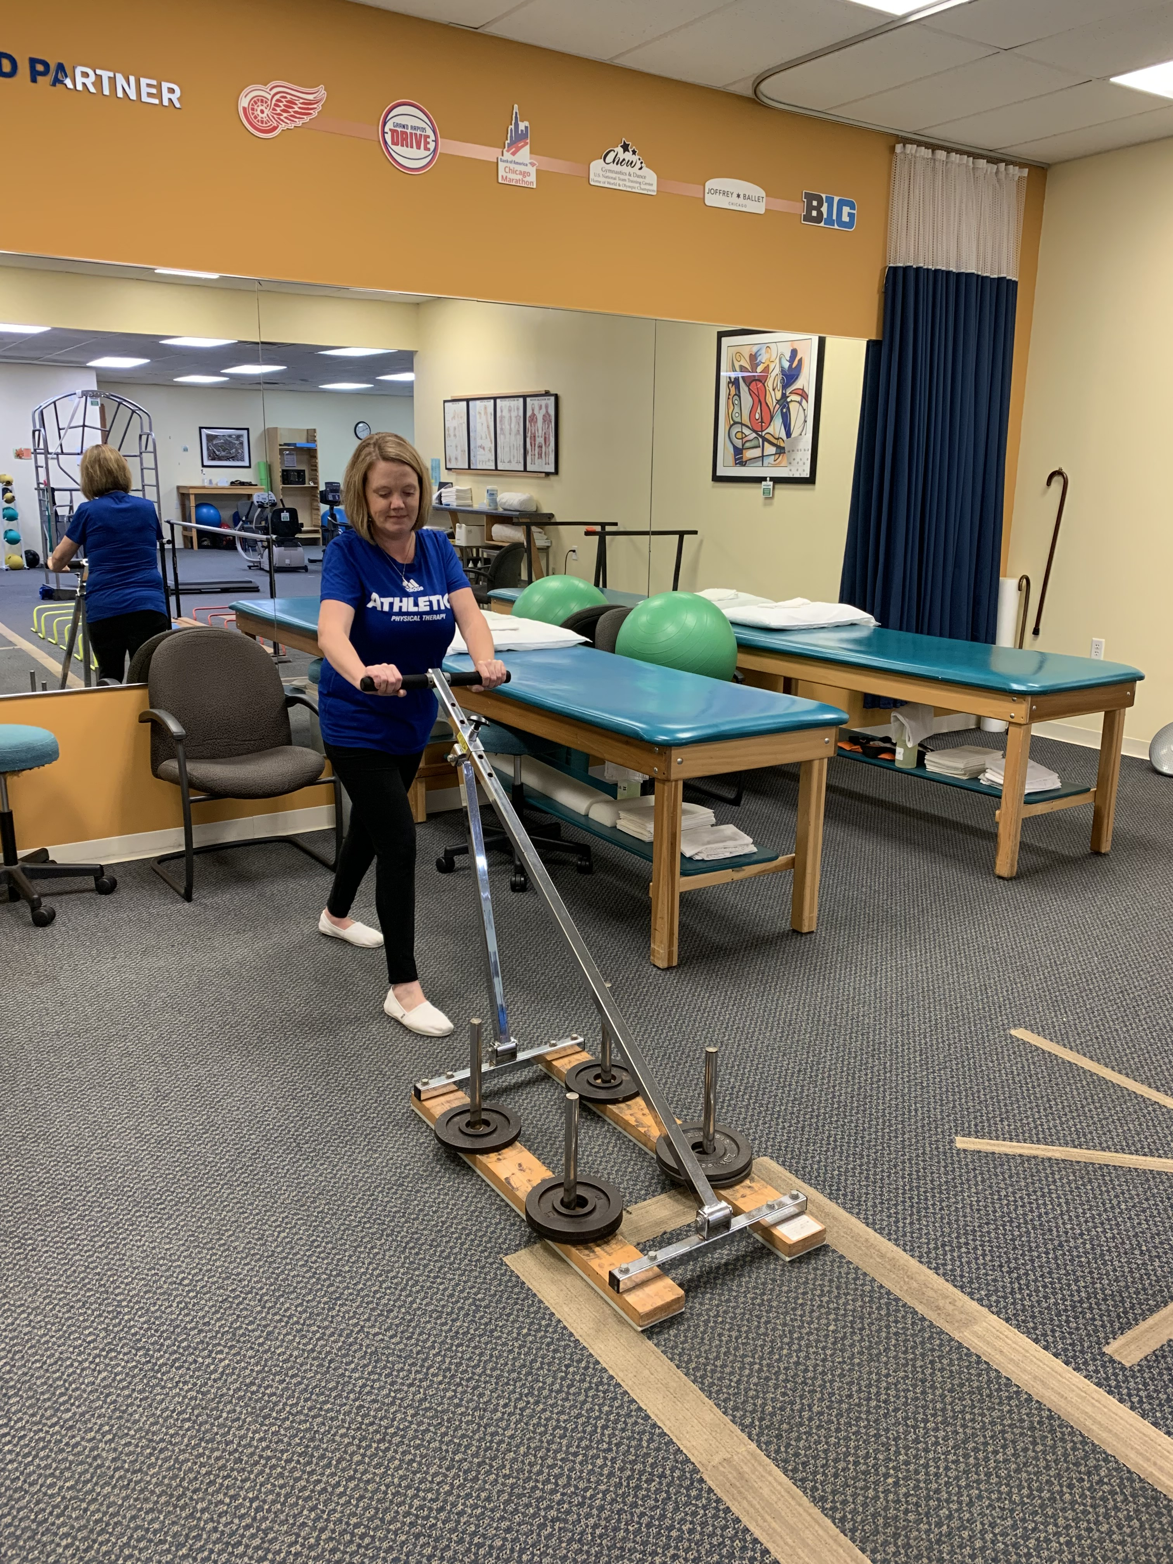
Treatment
Strengthening
  Start 30-60% 1RM
    12-20 reps
  Progress to 60-80% within 2 weeks
    8-12 reps
Balance/Gait
  SPC – HHA – Gait belt
Function
  Stair climbing, farmer’s carry, sled push, crate lifts

Slide 58
Objective Findings
 | Eval: 7-19-2021 | Discharge: Insurance Auth
LEFS | 6/80 | 48/80
5x Sit to Stand | 33 seconds with UEs | 17 seconds no UEs
Gait Speed | 0.5 m/s (4ww) | 0.85 m/s (SPC) 0.75 m/s (no AD)
TUG | 22 seconds with 4ww | 12 seconds no AD

Slide 59
Take Aways
Build Rapport and Gain Trust
Listen to Your Patient’s Goals
Educate on Expectations
Be Realistic
Challenge Your Patients
Keep it Fun

Slide 60
Questions?

